Slide 1
PART 4
COMMANDS

Slide 2
Commands are useful to communicate with database.
There are 5 types of SQL Command Languages
DDL (Data Defination Language)
DML (Data Manipulation Language)
DQL (Data Query Language)
TCL (Transaction Control Language)
DCL (Data Control Language)
DDL | DML | DQL | TCL | DCL
Create | Insert | Select | Commit | Grant
Alter | Update |  | Roll back | Revoke
Drop | Delete |  | Save point
Truncate

Slide 3
DDL
It is used to create and modify the structure of database objects in the database and only works with descriptions of the database schema.
Although data cannot be created, modified, or deleted with DDL, database structures can.
Create the database or its objects.
CREATE DATABASE database_name
CREATE TABLE table_name (
column1 datatype,...);
Create
ALTER TABLE table_name ADD column_name datatype;
ALTER TABLE table_name DROP COLUMN column_name;
ALTER TABLE table_name MODIFY column_name datatype;
Alter
This is used to change the database’s
structure
Drop
Use the DROP command to remove
objects from the database.
DROP DATABASE database_name;
DROP TABLE table_name;
Truncate
Used to eliminate every record from
a table
TRUNCATE TABLE table_name;

Slide 4
DML
SQL statements are part of the DML which is used to manipulate data that is present in data-
bases.
It is part of the SQL statement in charge of managing database and data access.
Insert
Data inserted into a table .
INSERT INTO table_name (column1, column2,..)
VALUES (value1, value2,..);
UPDATE table_name
SET column1 = new_value1
WHERE condition;
Update
Table existing data is updated
Delete
Delete records from a database
table
DELETE FROM table_name
WHERE condition;

Slide 5
DQL
DQL is a sublanguage of SQL that is used to query data from a database.
It is a declarative language, which means that you tell the database what you want, not how to
get it.
DQL statements are made up of keywords, operators, and values.
Some common DQL keywords include SELECT, FROM, WHERE, and ORDER BY
There are two types of inserting data—
Implicit inserting – inserting data for all columns present in a table.
Explicit inserting – inserting data only in a specific column
SELECT *
FROM customers;
SELECT *
FROM customer_orders
WHERE customer_id = 100;
Retrieves data from one or
more tables.
Select

Slide 6
TCL
SQL statements are part of the DML which is used to manipulate data that is present in data-
bases.
It is part of the SQL statement in charge of managing database and data access.
Commit
Save changes made during transactions
( queries… )
COMMIT;
Roll-Back
(query)
ROLLBACK;
Revert changes if any error occurs.
A point within a transaction where
you can roll back to a specific state
without affecting the entire
transaction.
Save Point
(query)
SAVEPOINT A;
ROLLBACK to A;

Slide 7
DCL
SQL statements are part of the DML which is used to manipulate data that is present in data-
bases. This is used by administrator side and not developers.
It is part of the SQL statement in charge of managing database and data access.
Grant
Grants specific privileges to user.
GRANT SELECT ON (table’s name)
FOR user@servername;
Revoke
Removes privileges from user.
REVOKE SELECT ON (table’s name)
FROM user@servername;

Slide 8
PRACTICAL IMPLEMENTATION

Slide 9
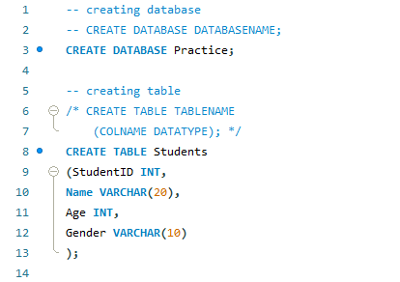
CREATE

Slide 10
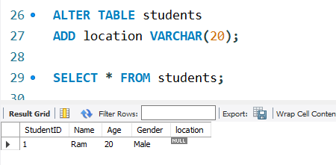
ALTER

Slide 11
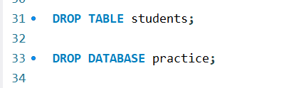
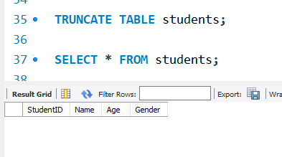
DROP
TRUNCATE

Slide 12
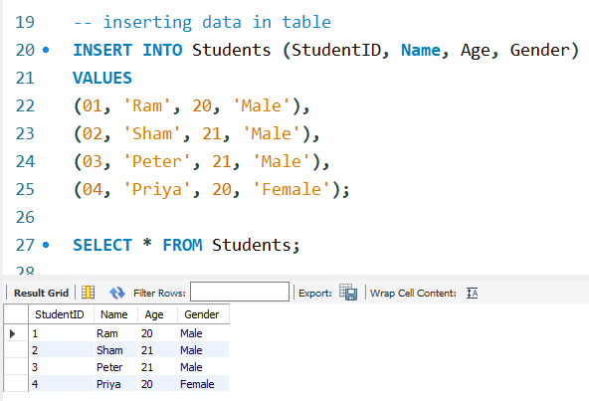
INSERT

Slide 13
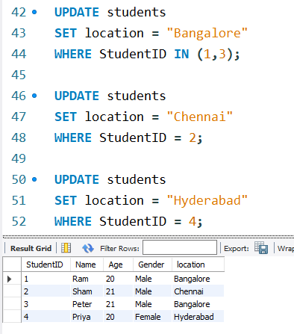
UPDATE

Slide 14
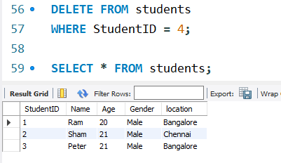
DELETE

Slide 15
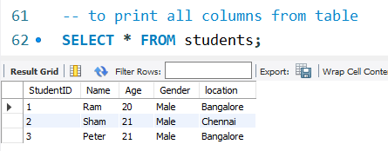
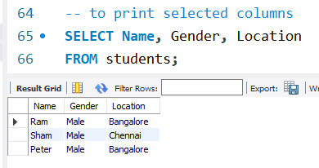
SELECT

Slide 16
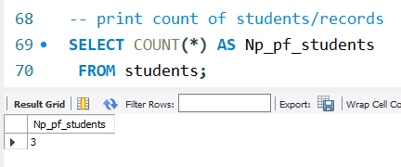

SELECT

Slide 17
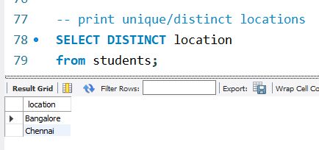
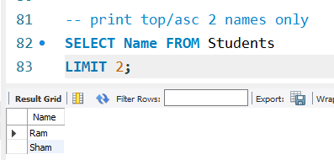
SELECT

Slide 18
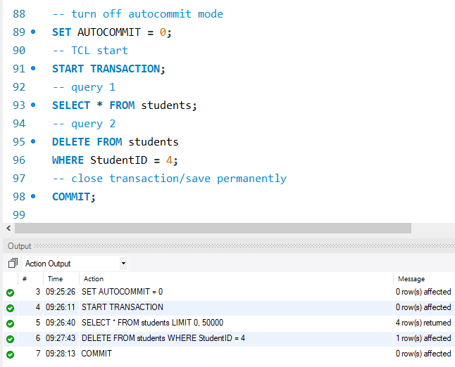
COMMIT

Slide 19
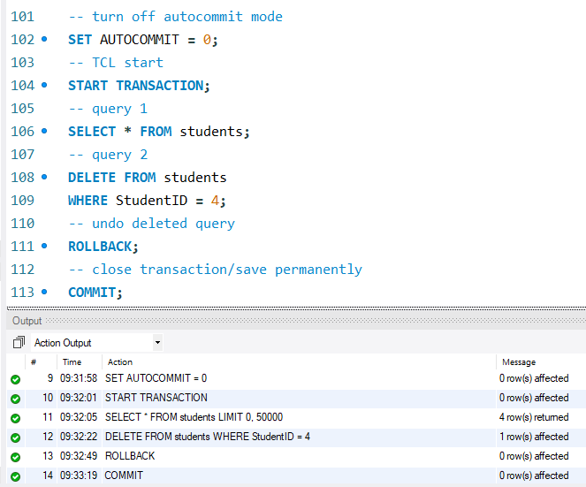
ROLLBACK

Slide 20
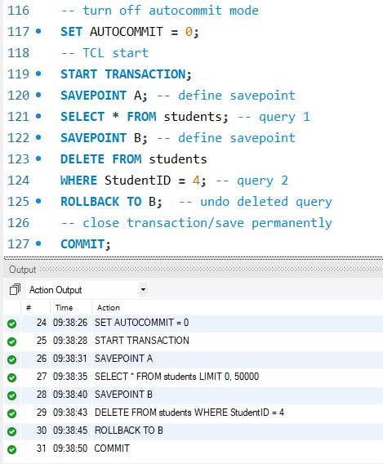
SAVEPOINT

